Slide 1
Open Questions and Research Tools in Nuclear Astrophysics
Lecture 1: nuclear physics
and multi-messengers
Liliana Caballero
University of Guelph

Slide 2
How and where are the heavy elements made?
What are the mechanisms of stellar explosions?
What is the nature and structure of matter under extreme conditions?

Slide 3
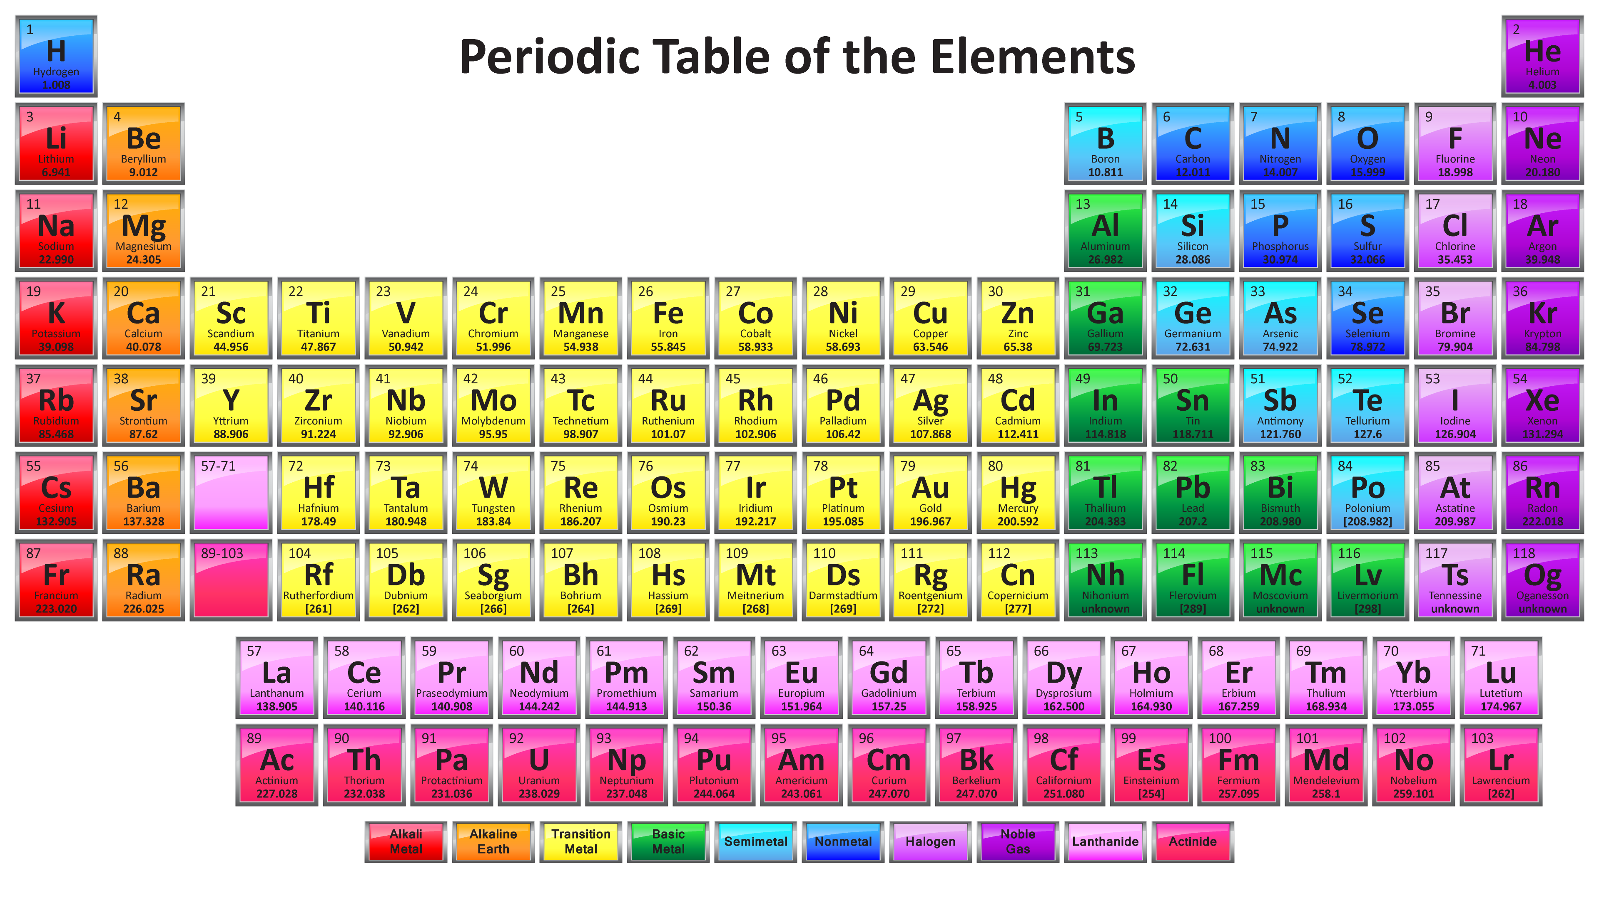
Synthesis of elements

Slide 4
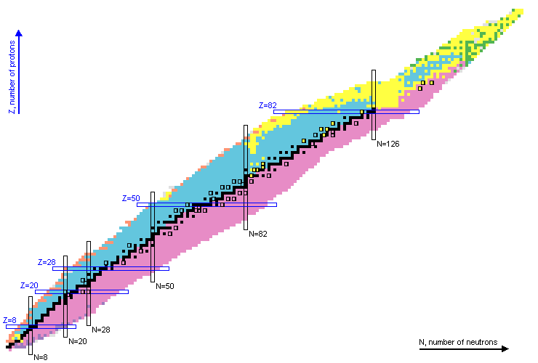
Nuclear Chart (NuDat 2.7 ) Brookhaven National Laboratory
https://www.nndc.bnl.gov/nudat2

Slide 5
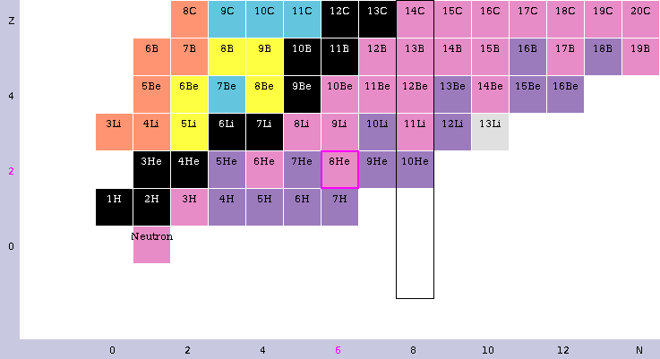

Slide 6
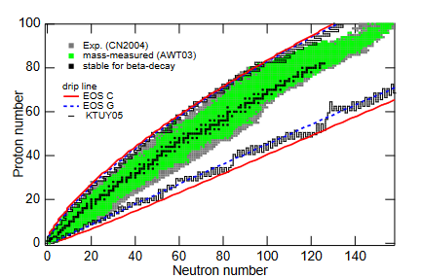
Proton and neutron drip lines
K. Oyamatsu et al PRC 2010

Slide 7
Why are different drip lines?
Because nuclear physicists haven’t studied those nuclei
Because the nuclear force is unknown
Because different nuclei get synthesized in different stars
Because experimental uncertainty was added

Slide 8
Why are different drip lines?
Because nuclear physicists haven’t studied those nuclei
Because the nuclear force is unknown
Because different nuclei get synthesized in different stars
Because experimental uncertainty was added

Slide 9
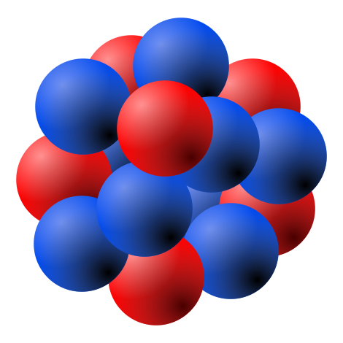
The Nuclear Force
Overpowers the electromagnetic force
Depends on spin and momentum
Includes two or more nucleons
At small distances is repulsive, at medium distances is strongly attractive and is zero at large distances

Slide 10
The Nuclear Force
is a not a fundamental force!

Slide 11
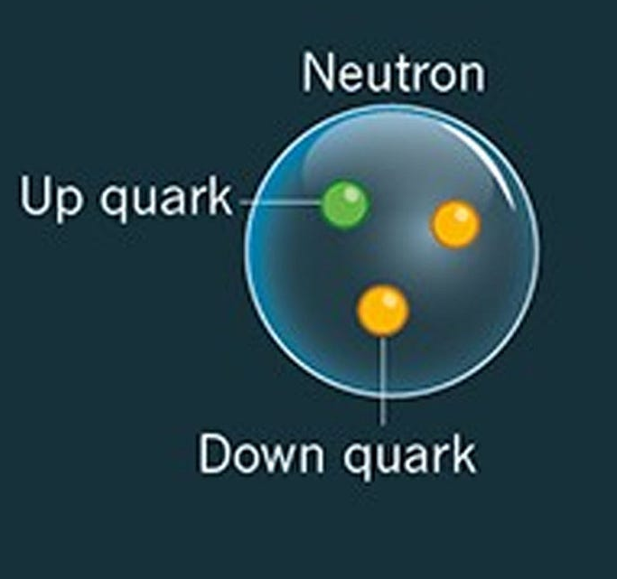
The Nuclear Force
is a not a fundamental force!

Slide 12
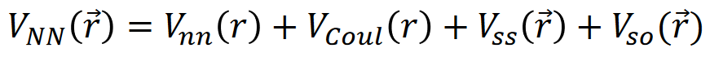
The nucleon-nucleon interaction
Central + Coulomb + Tensor + Spin-orbit

Slide 13
Nuclear Physics
(alpha, beta, gamma) decay rates
Capture rates
Nuclear masses
Energy levels
Fission
Say you want to study ²³⁸U

Slide 14
Nuclear Physics
Many body problem N=238
Nucleon interaction
Say you want to study ²³⁸U

Slide 15
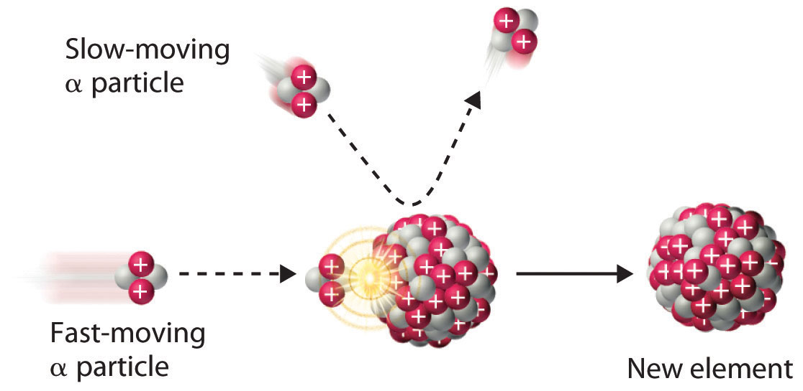
How are elements synthesized?
Nuclear reactions

Slide 16
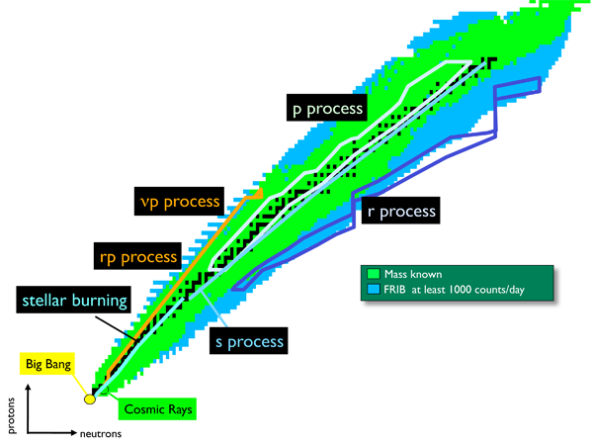
How much?
Fusion

Slide 17
How and where are the elements produced?
Accreting Neutron stars
Supernovae
mergers with Neutron stars
Fusion

Slide 18
Up to date we do not fully understand how much of each element is produced in the Universe
What to do to solve this kind of puzzles?

Slide 19
What to do to solve this kind of puzzles?
Smash matter in a lab
Burn supercomputers with endless simulations
Spend a lot of money to build astro observatories
All the above

Slide 20
What to do to solve this kind of puzzles?
Smash matter in a lab
Burn supercomputers with endless simulations
Spend a lot of money to build astro observatories
All the above

Slide 21
Site simulation:
1D-3D,
Hydro, steady-state
GR, PseudoN
T, d, Ye, L
Nuclear physics input: Theory & Experiment.
e.g. EOS
Outbound matter, Nucleosynthesis,
Gravitational waves, neutrinos
=?= observation
yes
NO
Multi-messengers

Slide 22
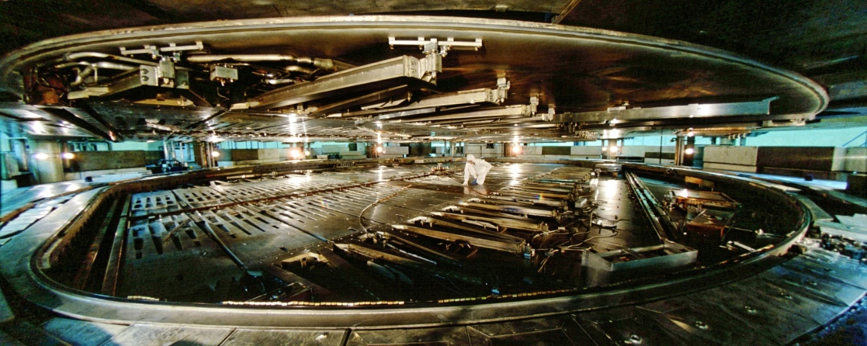
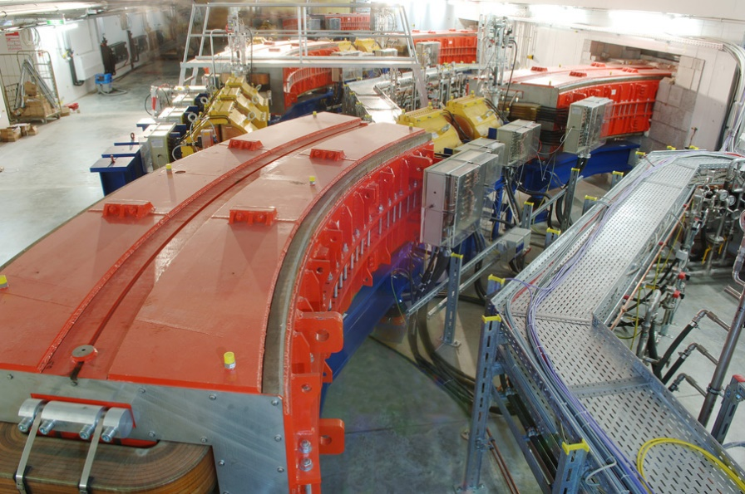
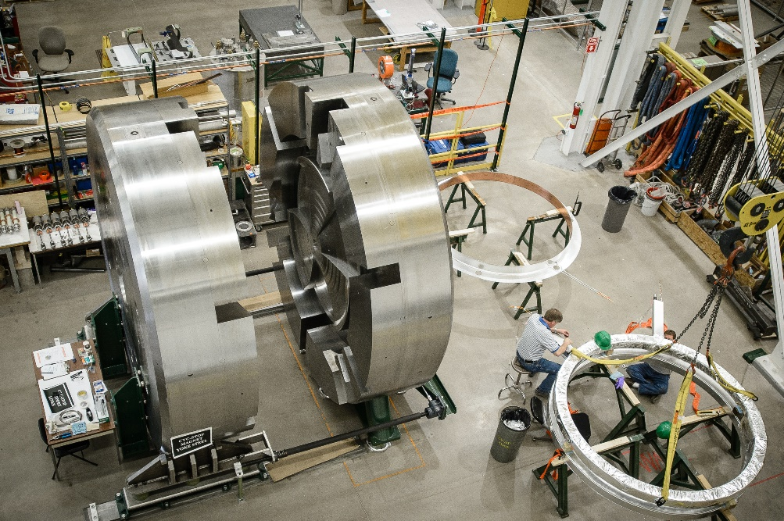
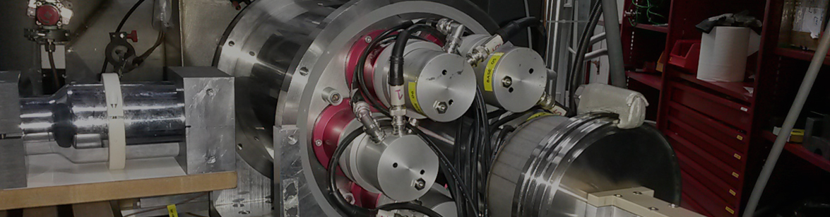
Some experimental facilities
TRIUMF
GSI
LUNA
FRIB

Slide 23
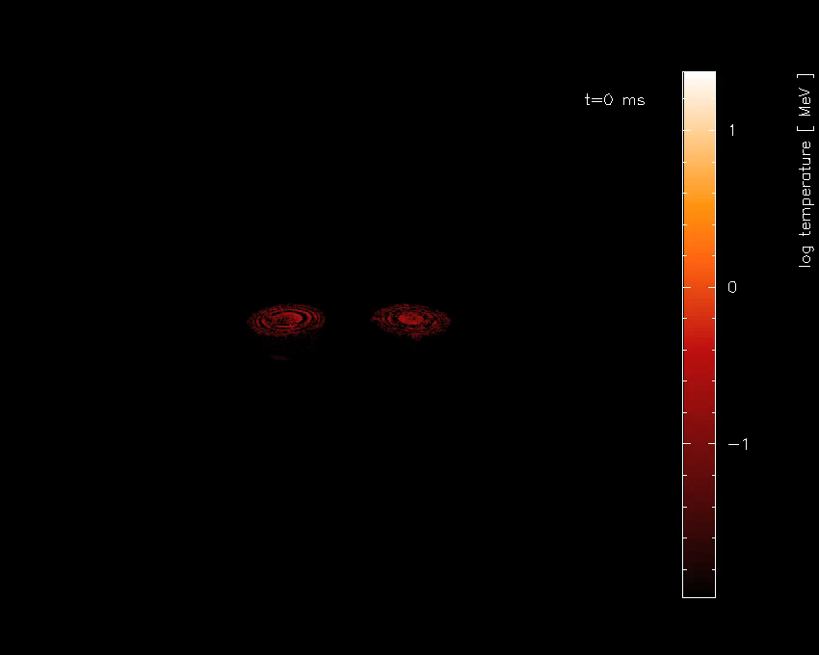
What do simulations tell us?
S. Rosswog et al, MNRAS 430 (2013)
GRB
GRB
Ejecta
Nucleosynthesis
Kilonova
Outflows
Nucleosynthesis

Slide 24
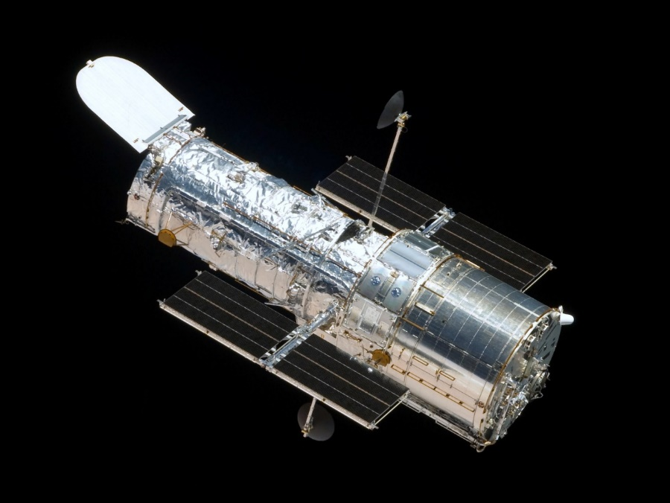
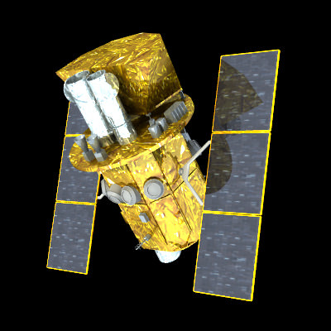
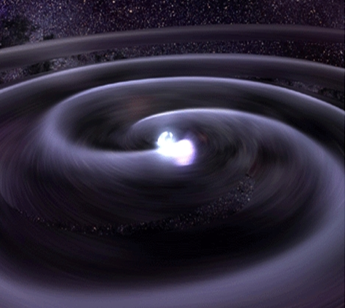
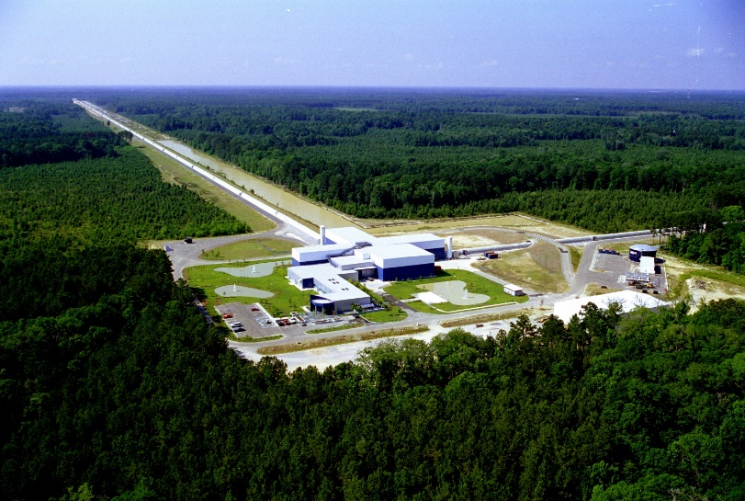
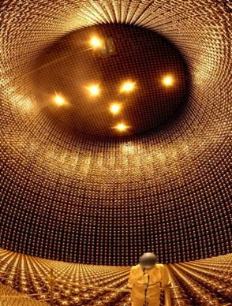
Multi-messengers
Gamma-rays: Swift
X-rays Chandra
Visible light:
Hubble Space Telescope
Las Campanas
Neutrinos: SuperK, SNOLab, DUNE
Gravitational Waves:
LIGO, Virgo, LISA

Slide 25
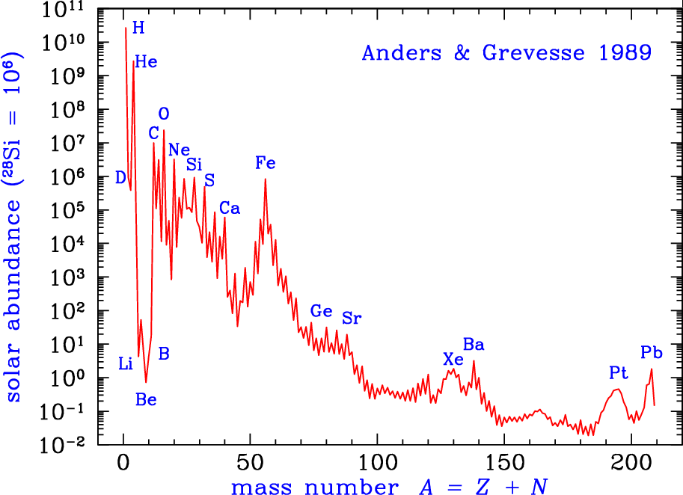
Observations
Earth, nebulae, Sun, meteorites,stars

Slide 26
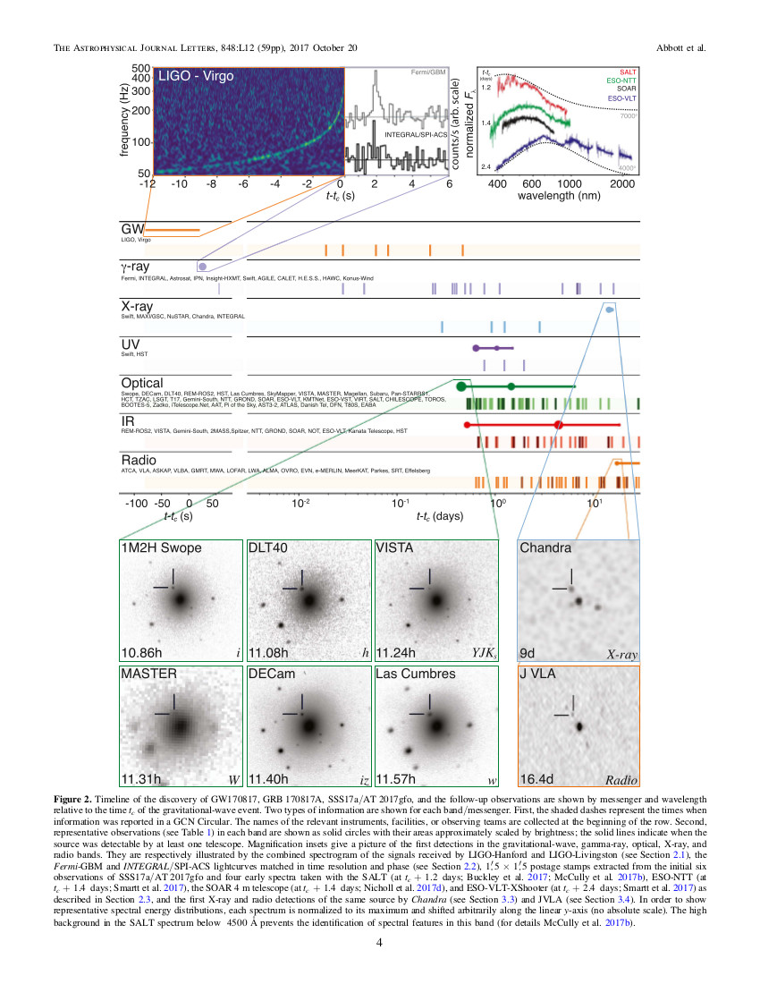
LIGO Collaboration, PRL 2017
ApJ Letters 848 2017
Multi-messenger era!
GM170817
First observation of
Neutron Star mergers
August 17th 2017
Distance =40 Mpc
0.4< q= m₁/m₂ <1
Early time evolution: A<140
Late time evolution: A~ 195
r-process nuclei

Slide 27
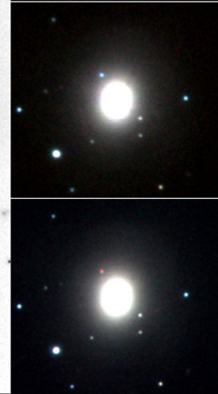
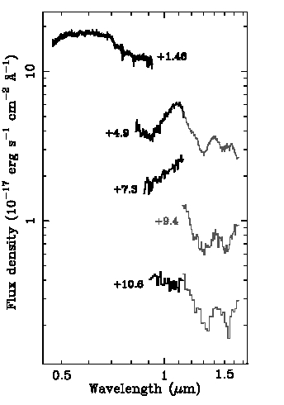
VISTA, Hubble, VLT
Tanvir et al ApJL (2017)
Early time evolution: Optical and near-IR
Low opacity then A<140 r-process nuclei
Ye >0.25 (How did it became less neutron-rich? probably due to interaction of material with neutrinos?)
Later time evolution
Near-infrared slower evolution than optical
Large opacity compatible
with r-process A~ 195

Slide 28
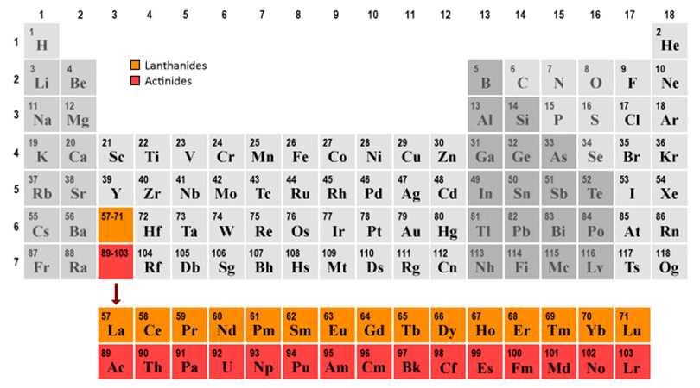
VISTA, Hubble, VLT
Tanvir et al ApJL (2017)
Early time evolution: Optical and near-IR
Low opacity then A<140 r-process nuclei
Ye >0.25 (How did it became less neutron-rich? probably due to interaction of material with neutrinos?)
Later time evolution
Near-infrared slower evolution than optical
Large opacity compatible
with r-process A~ 195

Slide 29
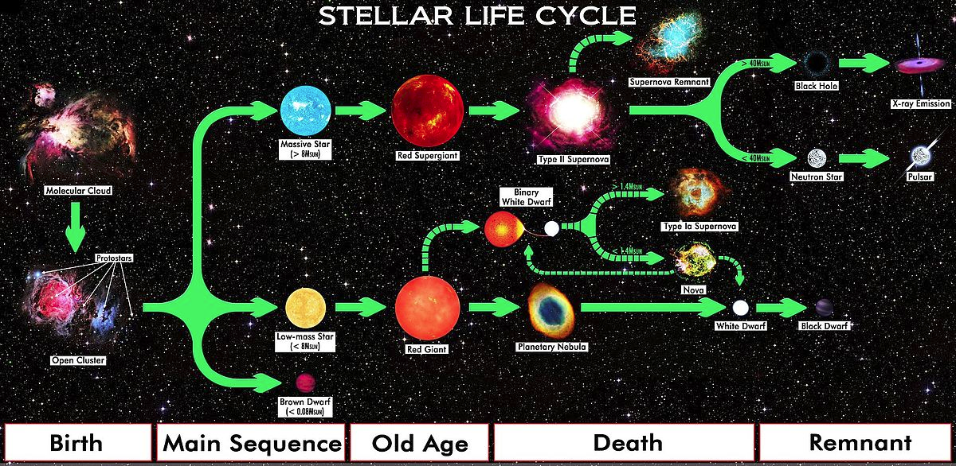

Slide 30
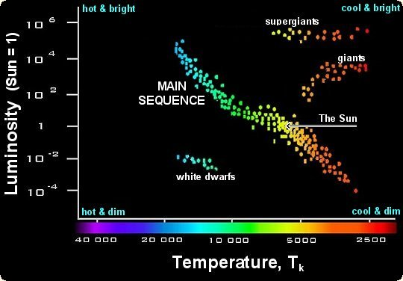
Hertzsprung-Russell Diagram
The larger (more massive) the star the faster burns fuel

Slide 31
A very simple model for stellar burning
Gravity contracts the initial Hydrogen gas: inward pressure
Density and temperature increase
Nuclear reactions are triggered: outward pressure, star shines
Balance is kept until fuel is exhausted
Next burning cycle

Slide 32
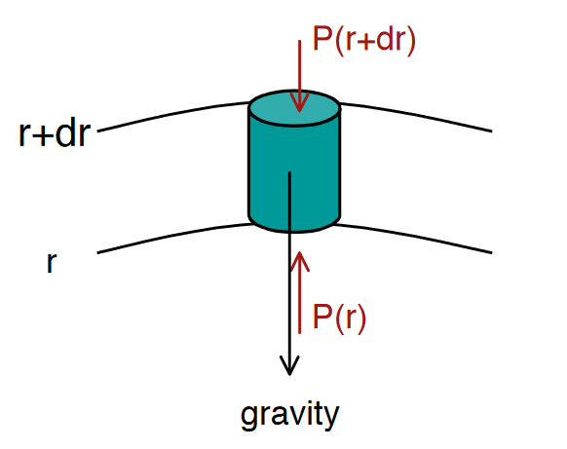
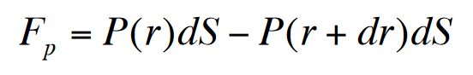
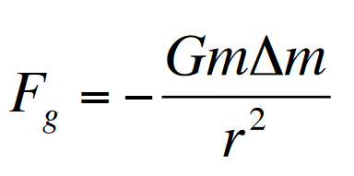
A very simple model for stellar burning

Slide 33
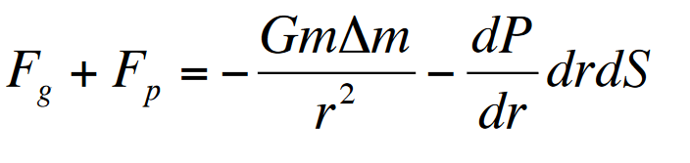
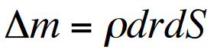
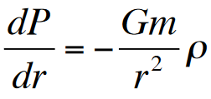
A very simple model for stellar burning
dS
Mass element

Slide 34
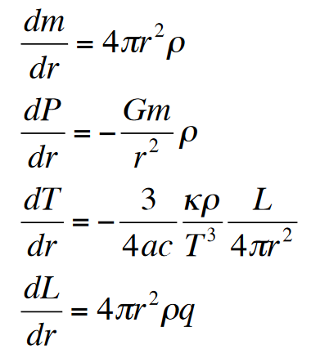
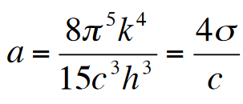

A very simple model for stellar burning
Mass conservation
Hydrostatic equilibrium
Energy transport
Opacity κ
Energy generation
Rate of energy generation per unit mass: ε [erg/g/s]
$$ε$$

Slide 35
A very simple model for stellar burning
P(T,ρ) Equation of State
Opacity (composition, e.g. electron scattering)
ε nuclear energy
Once you get the above, the structure equations can be solved numerically
Boundary conditions: m=0 at r=0, m=M at r=R, ρ (R ) =0

Slide 36
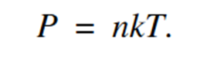
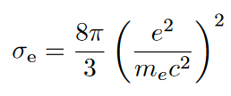
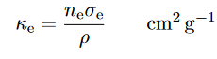
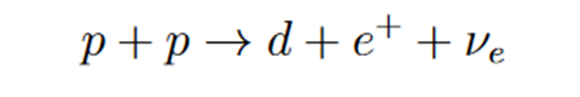
A very simple model for stellar burning
P(T,ρ) Equation of State
Opacity (composition, e.g. electron scattering)
ε nuclear energy
Once you get the above, the structure equations can be solved numerically
Boundary conditions: m=0 at r=0, m=M at r=R, ρ (R ) =0

Slide 37
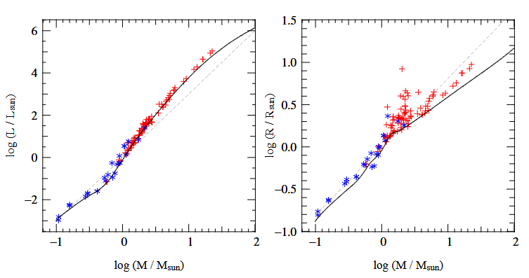
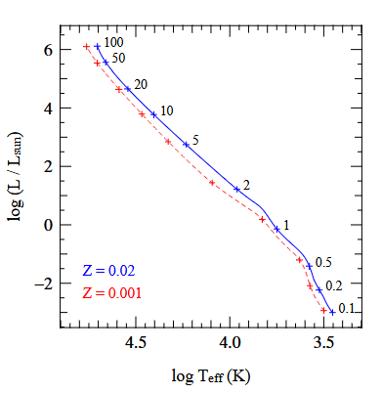
A very simple model for stellar burning
Symbols are observations. Initial composition X= 0.7, Z. Numbers indicate initial mass
https://www.ucolick.org/~woosley/ay112-14/texts/pols11.pdf

Slide 38
A very simple model for stellar burning
X= 0.7
https://www.ucolick.org/~woosley/ay112-14/texts/pols11.pdf

Slide 39
Take away messages
There are puzzles in astronomical observations due to our lack of knowledge of the nuclear force and nuclear reactions
Simple models match main features of observations
Multi-messenger astronomy, nuclear experiment, theory and astrophysics are all needed to advance the field

